Slide 1
Introduction to Machine Learning

Slide 2


Define Artificial Intelligence (AI) and understand its relationship with data
Explain Machine Learning (ML) and understand its relationship with Artificial Intelligence and Data Science
Understand Machine Learning approaches
Identify the applications of Machine Learning

Slide 3
Emergence of Artificial Intelligence

Slide 4
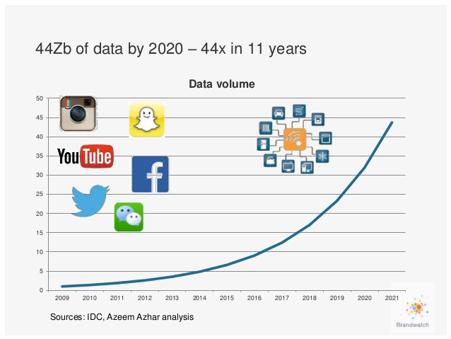
Data Economy
Data explosion has given rise to a new economy, and there is a constant battle for ownership of data between enterprises to derive benefits from it.

Slide 5
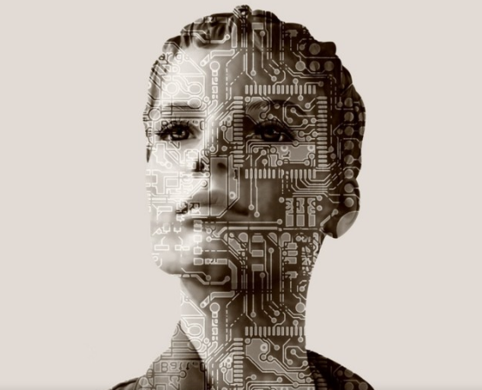
Emergence of Artificial Intelligence
Science associated with data is moving towards a new paradigm where machines can be taught to learn from data and derive insights to develop Artificial Intelligence.

Slide 6


Definition of Artificial Intelligence
Artificial Intelligence refers to intelligence displayed by machines that simulate human and animal intelligence.

Slide 7
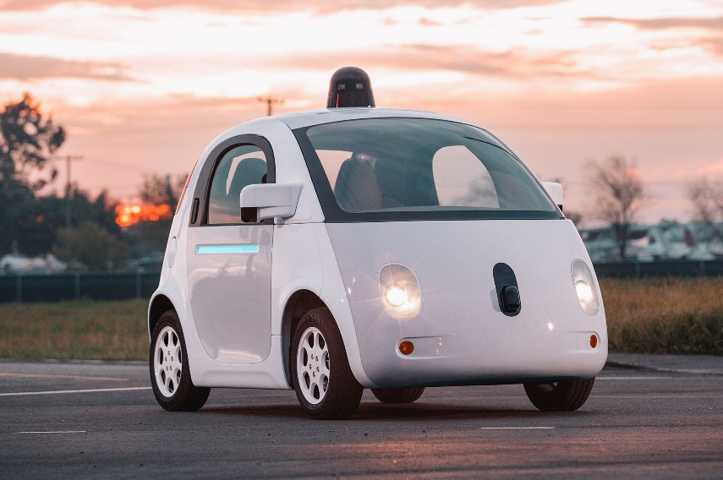

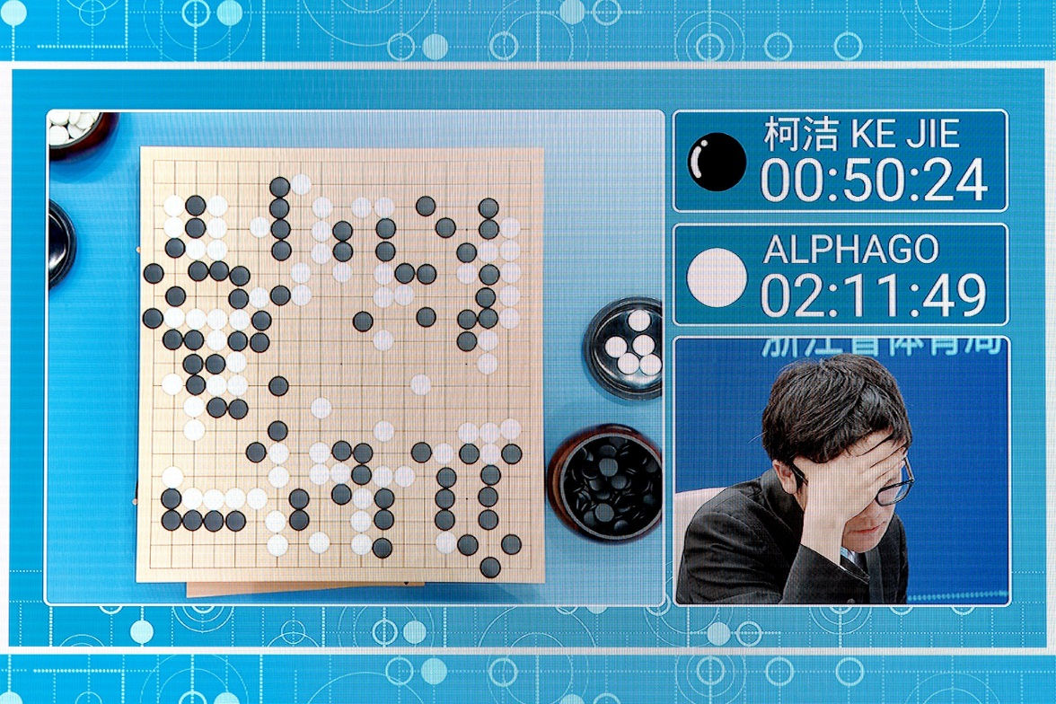
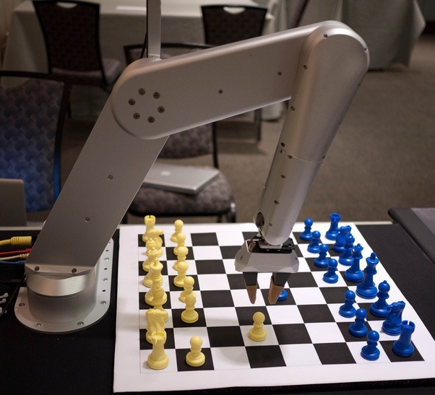


Artificial Intelligence in Practice
AI is redefining industries by providing greater personalization to users and automating processes.
Self-driving cars
Siri (iPhone)
Google’s AlphaGo
Chess
Amazon ECHO
Concierge robot from IBM Watson
Sources: documentarytube, wired, Quora

Slide 8



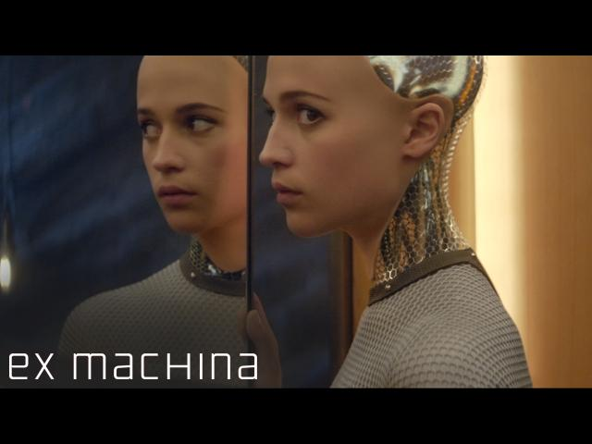


Sci-Fi Movies with the Concept of AI
Few AI films spanned through the decades reflect our everchanging spectrum of emotions regarding the machines we have created.

Slide 9

Data Facilitates in Recommendations
Amazon collects data from users and recommends the best products according to the user's buying or shopping pattern.

Slide 10
Relationship Between AI, ML, and Data Science

Slide 11
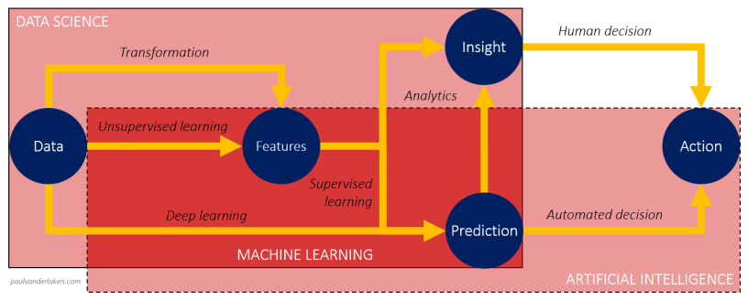
Relationship Between Artificial Intelligence, Machine Learning, and Data Science
Even though the terms Data Science, Machine Learning, and Artificial Intelligence (AI) fall in the same domain and are connected to each other, they have their specific applications and meaning.

Slide 12
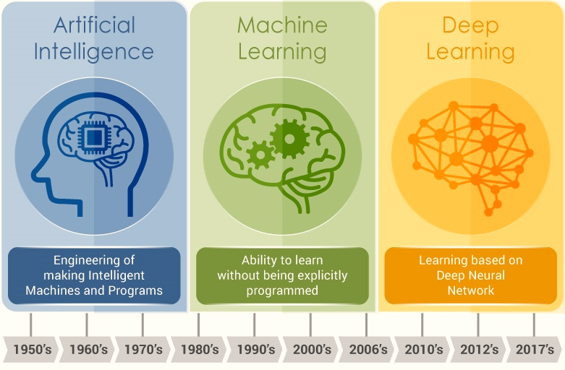
Relationship Between Artificial Intelligence and Machine Learning
Machine Learning is a subset of Artificial Intelligence that is based on the idea that machines can be given access to data along with the ability to learn from it.

Slide 13
Definition of Machine Learning
The capability of Artificial Intelligence systems to learn by extracting patterns from data is known as Machine Learning.

Slide 14
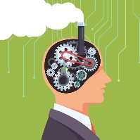


Features of Machine Learning
It uses data to detect patterns in datasets and adjust program
actions accordingly.
01
It focuses on the development of
computer programs that can teach
themselves to grow and change
when exposed to new data.
02
It enables computers to find hidden insights using iterative algorithms without being explicitly programmed.
03
It automates
analytical model building.
04

Slide 15
Machine Learning Approach

Slide 16







Traditional Approach vs. Machine Learning Approach
Traditional Programming: Data and program is run on the computer to produce the output.
Machine Learning: Data and output is run on the computer to create a program.
Data
Data
Model
Output
Program
Output

Slide 17
Traditional Approach
Traditional programming relies on hard-coded rules.
Production
Pass
Problem at hand
Code the Rules
Evaluate
Fail
Review errors

Slide 18
Machine Learning Approach
Machine Learning relies on learning patterns based on sample data.
Training Data
Example: (x1, y1), (x2, y2)
Production
Pass
Problem at hand
Train ML algorithm
Evaluate
Fail
Review errors

Slide 19

Relationship Between Machine Learning and Data Science
Data Science and Machine Learning go hand in hand. Data Science helps evaluate data for Machine Learning algorithms.

Slide 20


Relationship Between Machine Learning and Data Science
Data Science is the use of statistical methods to find patterns in data.
Statistical Machine Learning uses the same math and techniques as Data Science.
These techniques are integrated into algorithms that learn and improve on their own.
Machine Learning facilitates Artificial Intelligence as it enables machines to learn from the patterns in data.

Slide 21
Machine Learning Techniques
Decision making
7
1
Classification
Visualization
6
Machine Learning
2
Categorization
Anomaly detection
5
3
Clustering
4
Trend analysis

Slide 22
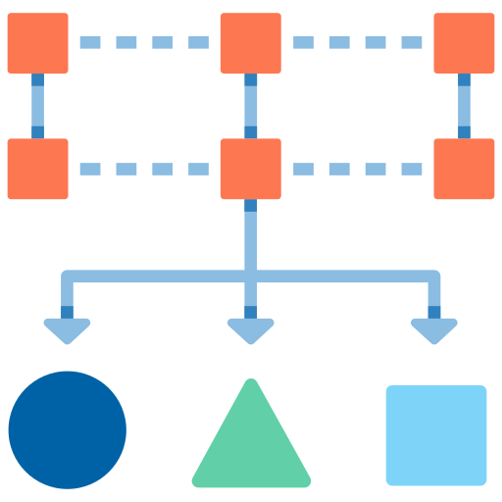
Machine Learning Techniques
Classification is a technique in which the computer program learns from the given data and uses it to classify new observations.

Slide 23
Machine Learning Techniques
Categorization is a technique of organizing data into
categories for its most effective and efficient use.

Slide 24

Machine Learning Techniques
Clustering involves grouping objects in such a way that those in the same group are more similar to each other than those in other groups.

Slide 25
Machine Learning Techniques
Trend analysis is a technique aimed at projecting both current and future movement of events by using time series data analysis.

Slide 26
Machine Learning Techniques
Anomaly detection is a technique to identify cases that are unusual within homogeneous data.

Slide 27

Machine Learning Techniques
Visualization is a technique to present data in a graphical format. It enables decision-makers to see analytics presented visually.

Slide 28
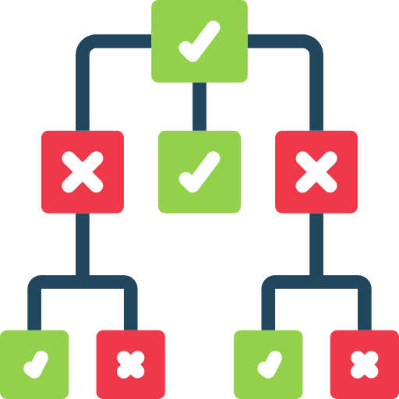
Machine Learning Techniques
Decision making is a technique or skill which provides you with the ability to influence managerial decisions with data as the evidence.

Slide 29
Applications of Machine Learning

Slide 30



Applications of Machine Learning
Artificial Intelligence and Machine Learning are being increasingly used in various functions such as:
Image Processing
Healthcare
Robotics
ML
Text Analysis
Data Mining
Video Games

Slide 31
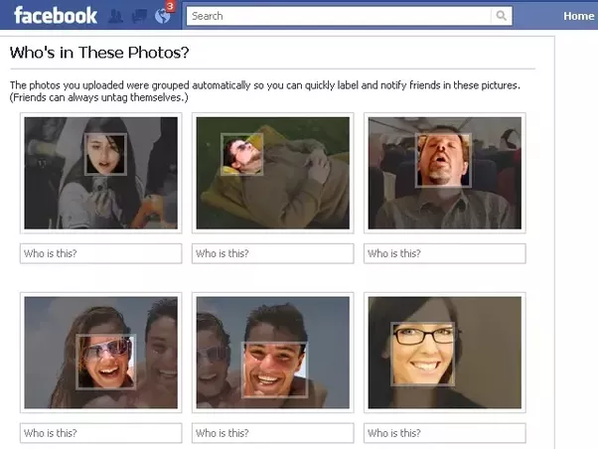
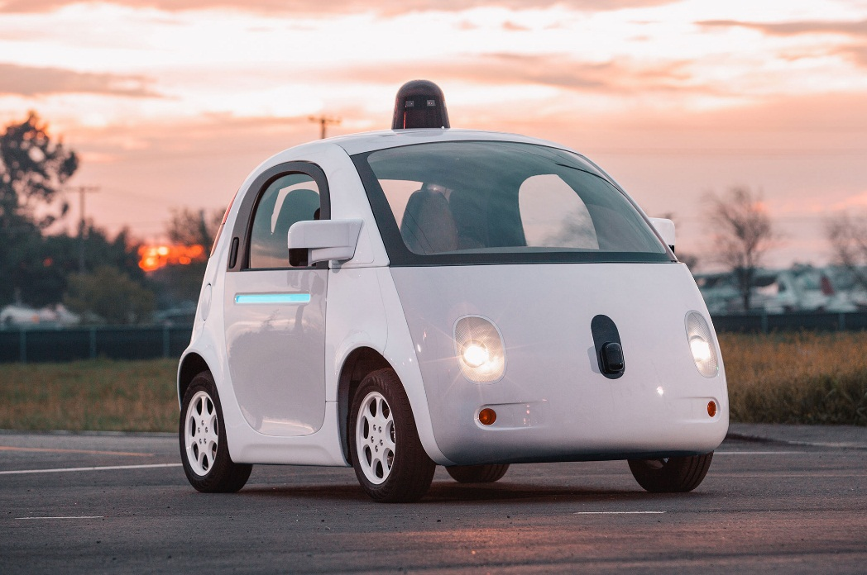
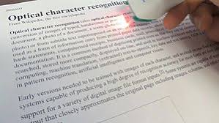
Applications of Machine Learning
Image Processing
Image tagging and recognition
ML
Self-driving cars
Optical Character Recognition (OCR)
Sources: Quora, documentarytube, Wikipedia

Slide 32
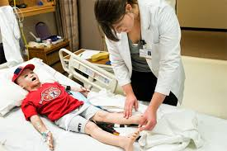
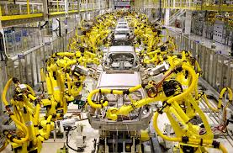
Applications of Machine Learning
Robotics
Human simulation
ML
Industrial robotics
Humanoid Robot
Sources: uiowa.edu, LinkedIn, Hilton

Slide 33

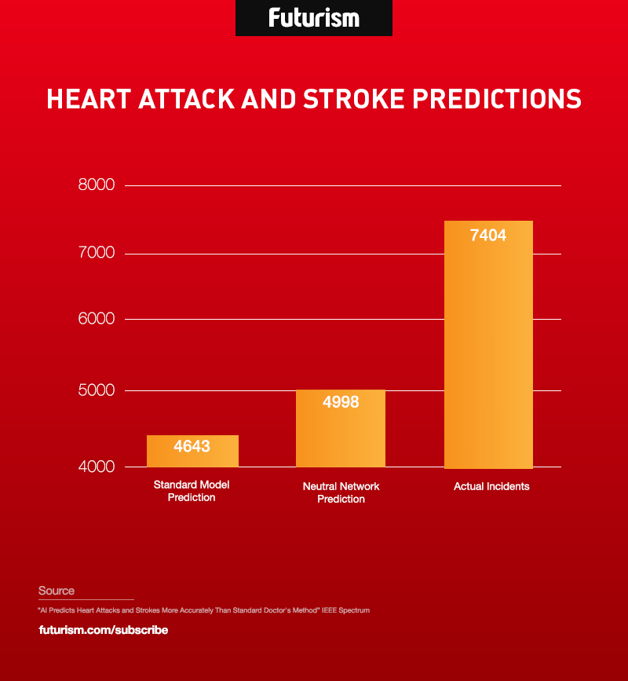

Applications of Machine Learning
Anomaly detection
Grouping and Predictions
ML
Data Mining
Association rules
Sources: dbta, Futurism

Slide 34

Applications of Machine Learning
ML
Some games implement reinforcement learning
Video Games
Sources: Quora

Slide 35

Applications of Machine Learning
Sentiment Analysis
Spam Filtering
Information Extraction
ML
Text Analysis

Slide 36
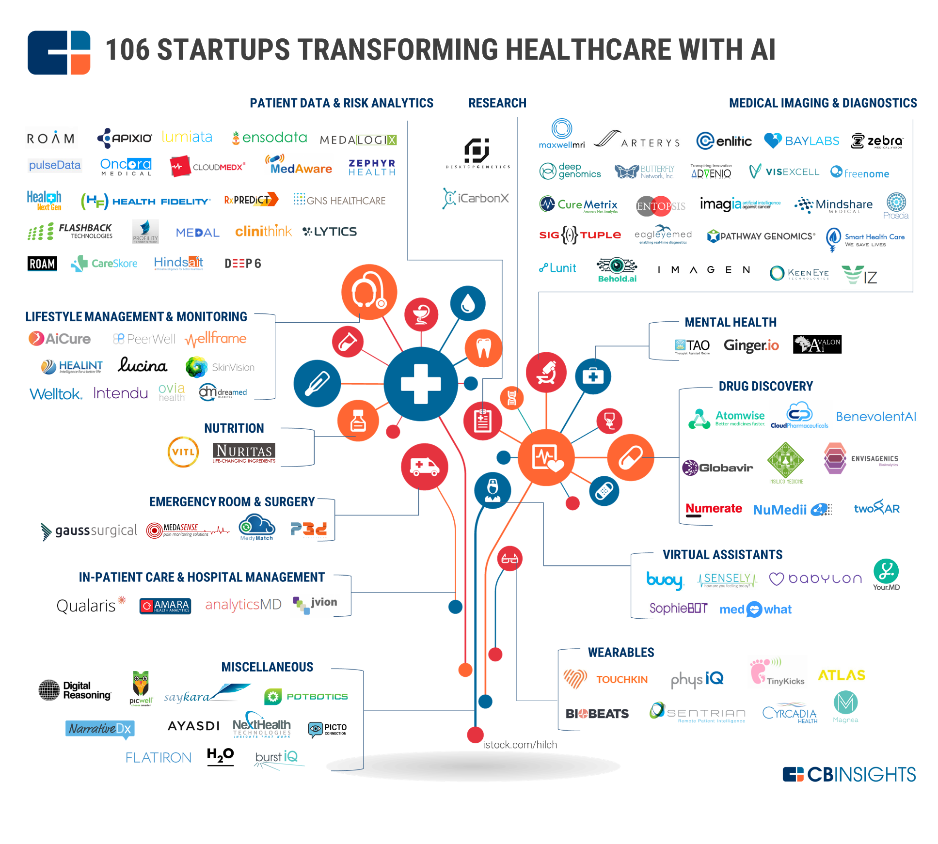
Applications of Machine Learning
Healthcare
ML
Source: cbinsights

Slide 38
Machine Learning is ____________________
1
An autonomous acquisition of knowledge through the use of algorithms
An autonomous acquisition of knowledge through the use of manual programs
A selective acquisition of knowledge through the use of computer programs
A selective acquisition of knowledge through the use of manual programs

Slide 39
Machine Learning is ____________________
1
An autonomous acquisition of knowledge through the use of algorithms
An autonomous acquisition of knowledge through the use of manual programs
A selective acquisition of knowledge through the use of computer programs
A selective acquisition of knowledge through the use of manual programs
A
Machine learning is an autonomous acquisition of knowledge through the use of algorithms.

Slide 40
What is the difference between traditional programming and machine learning?
2
Traditional programming is based on permutations and combinations, whereas machine learning uses traditional analytics.
Traditional programming considers output of the program to generate code, whereas machine learning uses data and program to generate output.
Traditional programming uses software programs, whereas machine learning uses hardware solutions.
Traditional programming uses hard-coded rules to make decisions, whereas machine learning learns from data.

Slide 41
What is the difference between traditional programming and machine learning?
2
Traditional programming is based on permutations and combinations, whereas machine learning uses traditional analytics.
Traditional programming considers output of the program to generate code, whereas machine learning uses data and program to generate output.
Traditional programming uses software programs, whereas machine learning uses hardware solutions.
Traditional programming uses hard-coded rules to make decisions, whereas machine learning learns from data.
D
Traditional programming uses hard-coded rules to make decisions, whereas machine learning learns from data.

Slide 42
The explosion of data has given rise to a new economy known as the data economy.
AI refers to the intelligence in machines that simulates human intelligence.
The capability of AI systems to learn by extracting patterns from data is known as machine learning.
Statistical Machine Learning uses the same math and techniques as Data Science.

